Slide 1
Home-made Wind Tunnel Project (not yet finished)
Arjan Sanghera

Slide 2
The Aim:
I wanted to create a low-cost small wind tunnel to test 1:18 scale cars at speeds of around 5-10ms^-1. I also wanted to be able to visualise the flow of air and collect data for drag and downforce/lift (if I want to test wings). I had a budget of £150

Slide 3
The structure of a wind tunnel:
The basic structure of a wind tunnel consists of:
Contractor to suck in air
Airflow straightener
Test section
Another airflow straightener
Diffuser
Fan

Slide 4
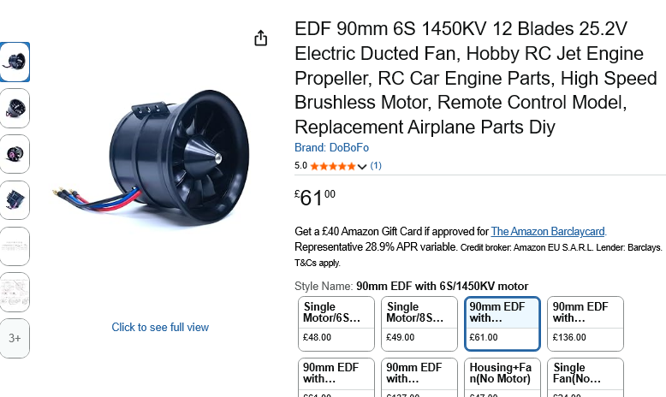


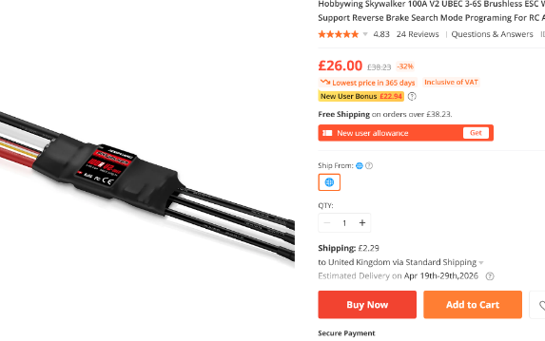
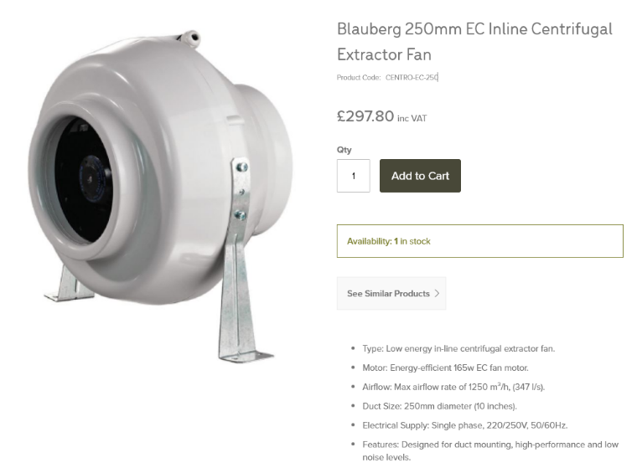
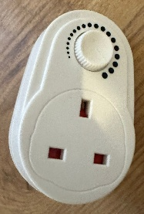
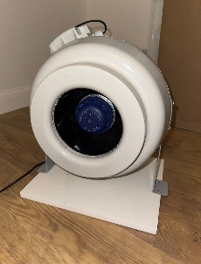
Choosing a fan:
When choosing a fan, I had to look for 2 key factors, flow rate (measured in CFM or m^3/hour), and static pressure (to overcome the resistance from the flow straighteners)
I wanted a fan with a flow rate of around 1000m^3/hour (588CFM) and a static pressure of 500Pa
Originally, I wanted to go for an EDF motor (used in model airplanes), however they are quite expensive (~£60), and that also meant I had to buy an electronic speed controller (~£25), LiPo battery (~50), and LiPo battery charger (~£20). But the final cost of just the fan ended up being (~£155), so I knew that this was just economically unviable
So I then did some further research and found a Blauberg industrial extractor fan (for £75 as it was on sale) with just the right specs I need, and it was half the price and just plug in and use, so I bought that instead
I then set it up and screwed it into a wooden base for support.
I then went and bought a plug-in lamp dimmer so I could adjust the speed of he fan and it worked
(It was on sale for £75 when I bought it)

Slide 5
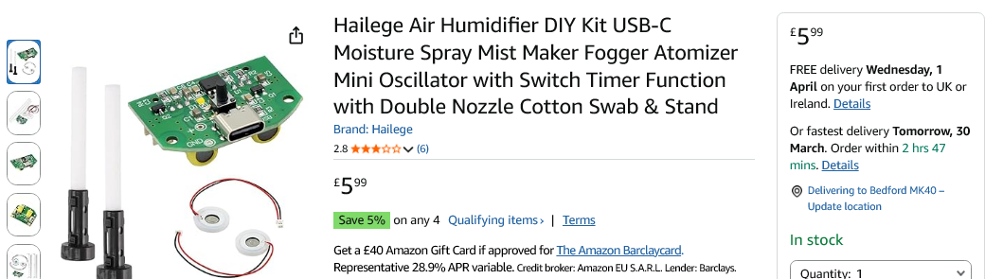
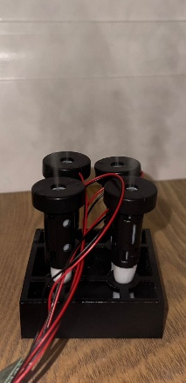
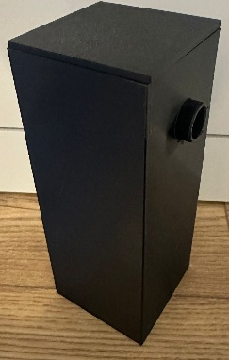
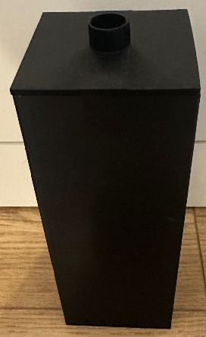
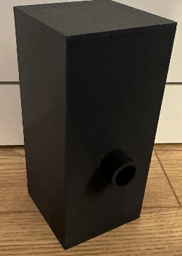
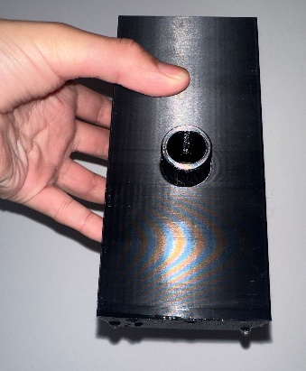
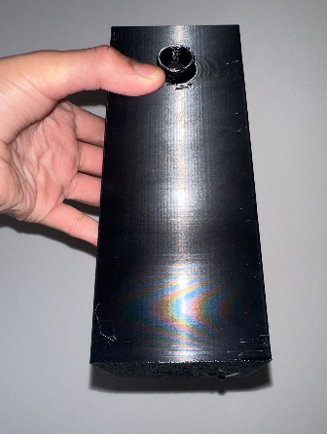
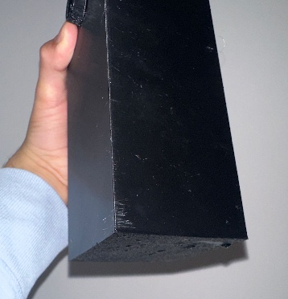
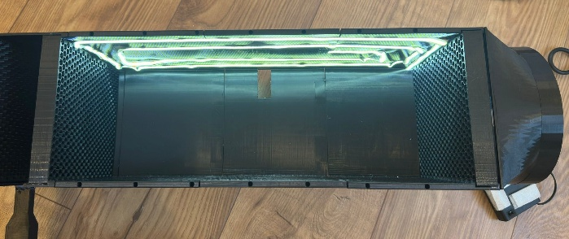
Smoke Generation:
I used 4 small ultrasonic water misters for smoke generation
When I first tested them, I created chambers that would direct the smoke, but no-matter how I directed the smoke, it just wouldn’t come out fast enough, so I decided to scrap the idea of having an external container for smoke generation and I decided to place the water misters inside the tunnel itself.
Also, many of my prints were leaking water, and after experimenting with printing with 100% infill, I found that the most effective way to make my prints watertight, were to print them sideways
To see the mist clearly in the tunnel, I will also use a strip of LEDs to illuminate the inside of the tunnel.

Slide 6
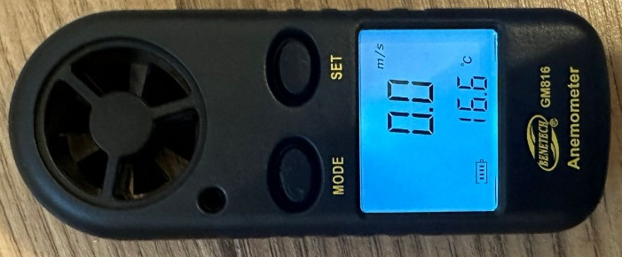
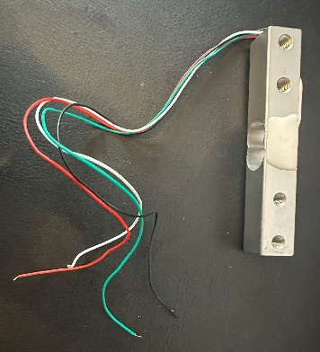
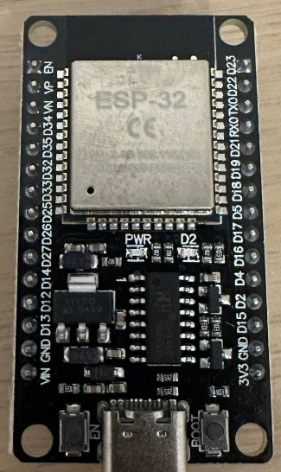
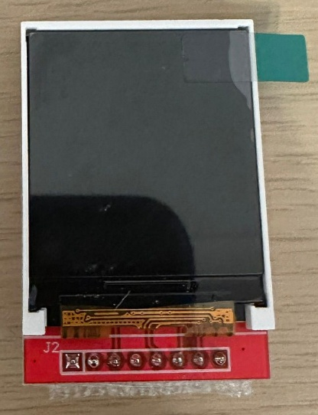
Collecting Data:
To get the wind speed, I will use an anemometer I bought for £10
To get data for the drag and downforce/lift, I will use 2 load cells, each connected to an ESP32 microcontroller which will display live readings on a screen and will also host a website to show more accurate results and graphs.

Slide 7
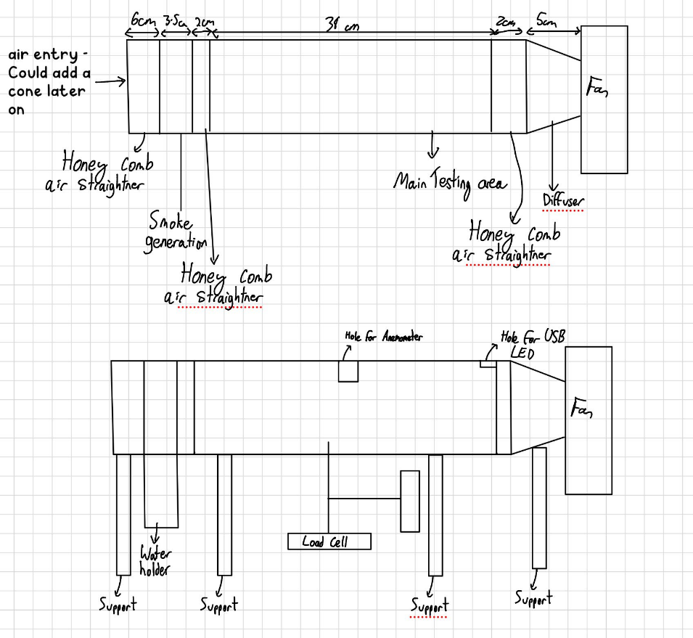
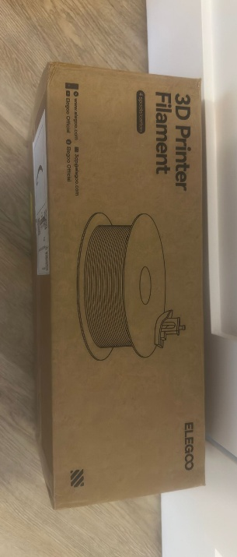
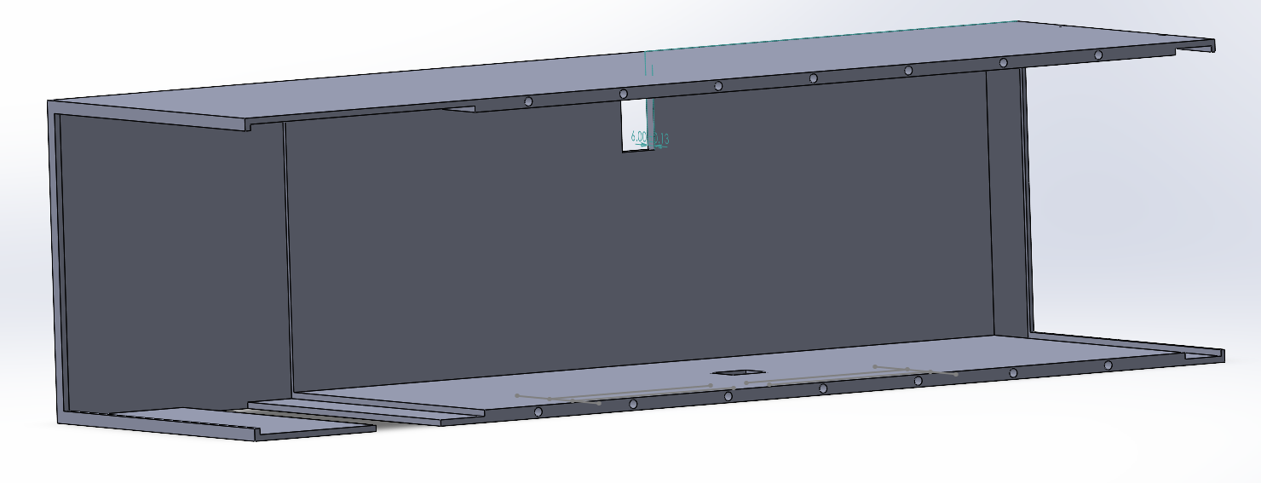
Designing the tunnel
I wanted to 3D print the tunnel using my 3D printer, so I bought 4kg of black Elegoo Rapid PETG for £40
I wanted the tunnel to have a cross section of 160x140mm to fit the model cars, and a length of around 400mm.
First, I sketched the design on my iPad, and then I took it to life in SolidWorks.
First, I built the main frame, ensuring to include the slots for the misters, air straighteners, anemometer, and LEDs

Slide 8
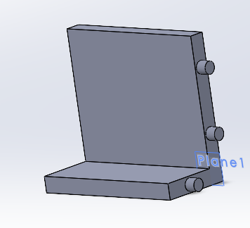

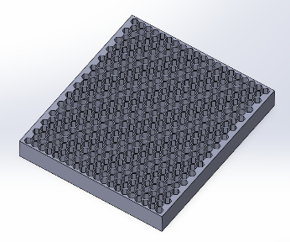
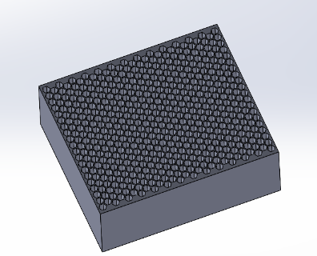
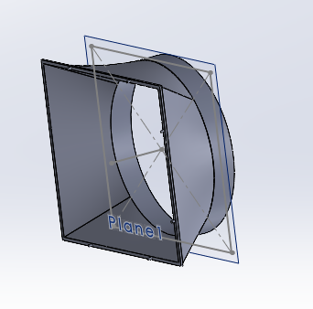
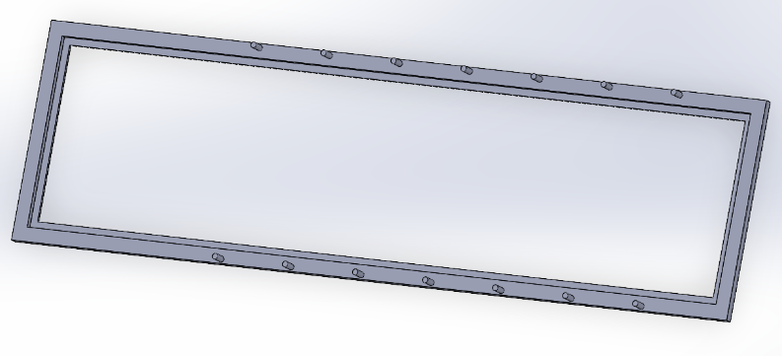
Designing the tunnel:
I then finalised the stand for the anemometer that would connect to the back of the main tunnel
Then I designed the air straighteners with a 7mm hexagon honeycomb structure. I need 2 20mm long ones, and a 60mm long one.
I then designed the diffuser to guide the back of the tunnel into the fan
Then I designed the window to connect to the main frame. I also ordered some clear Perspex to use as a window.

Slide 9
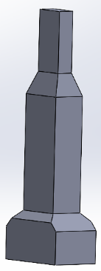
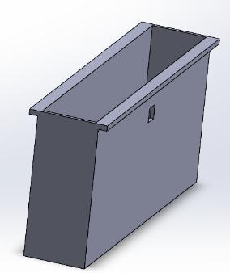
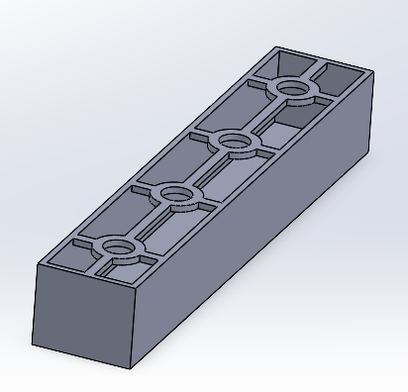
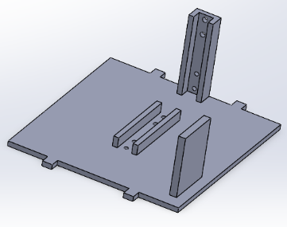
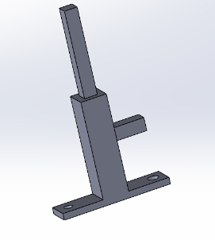
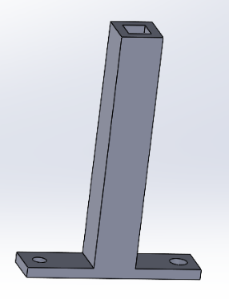
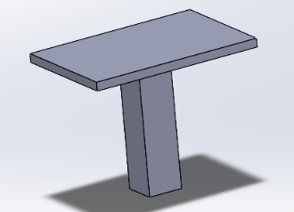
Designing the tunnel:
Then I designed the supports to help lift the tunnel up so that it is inline with the fan.
Then I made the compartment to hold the misters. I also created an insert to hold the misters to ensure that the water doesn’t leak.
Then I made the stand that would house all the electronics and had screw holes for the load cells (M4 and M5 screws)
Finally, I made the stand that would support the model

Slide 10
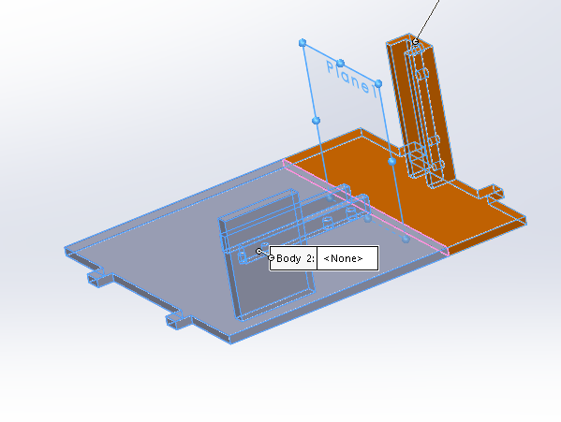
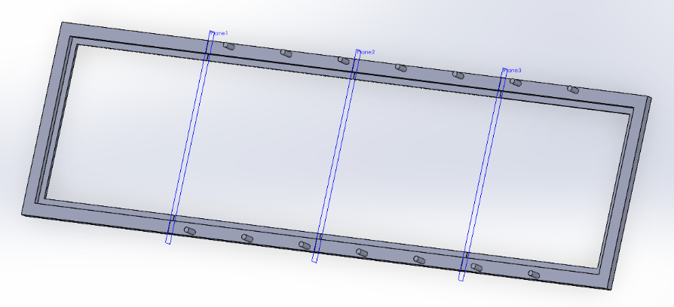
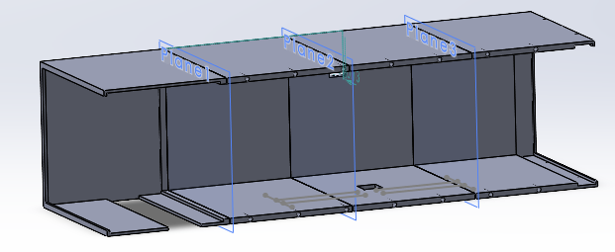
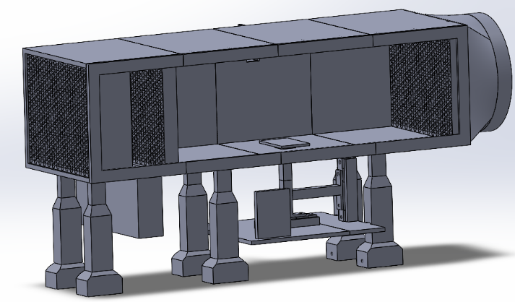
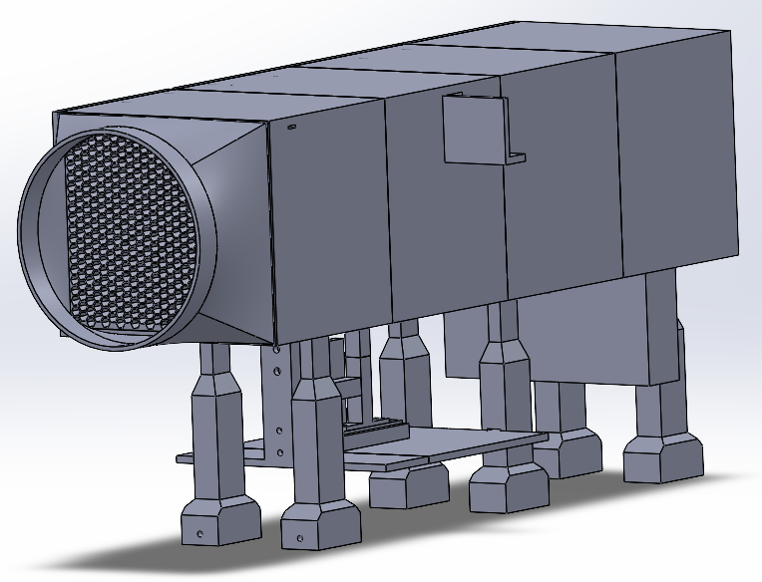
Designing the tunnel:
I then split up everything that was too big to print as one (the main frame, window, and electronics stand), into smaller pieces, including small joints to help alignment and strength when glueing them together
I then put everything together in a SolidWorks assembly to ensure that everything fit together well

Slide 11
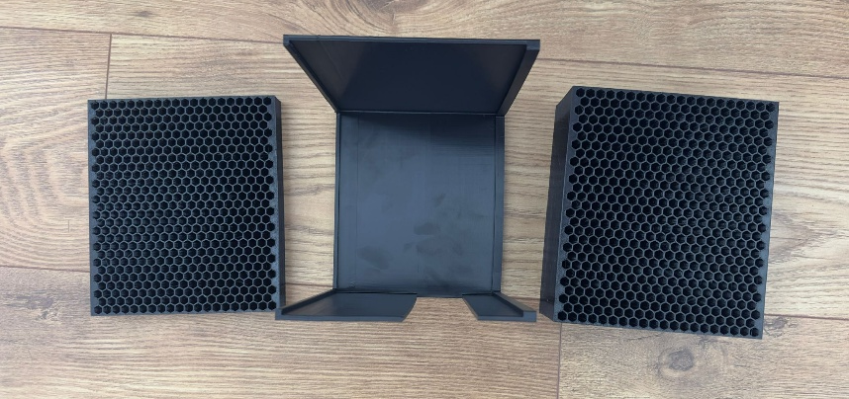
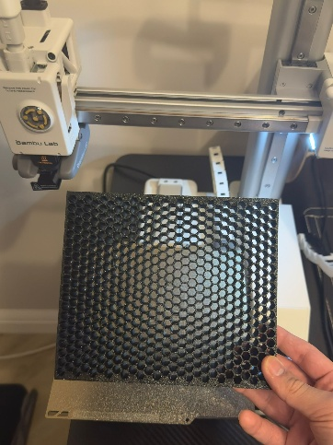
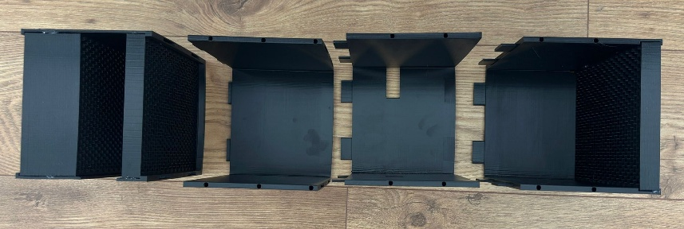
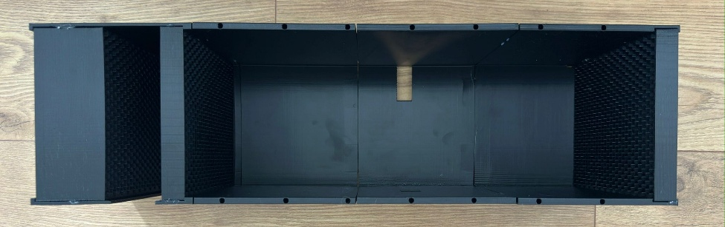
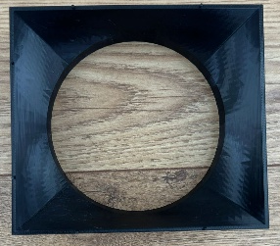
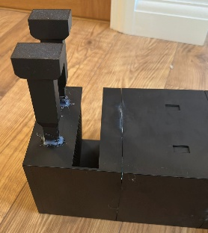
Building The Tunnel:
I first printed out the main frame and the honeycomb air straighteners, and I glued the honeycombs into the parts of the main frame.
I then glued the entire frame together and added on the anemometer stand.
I then glued the diffuser on the end
I then glued the first 2 supports onto the stand

Slide 12
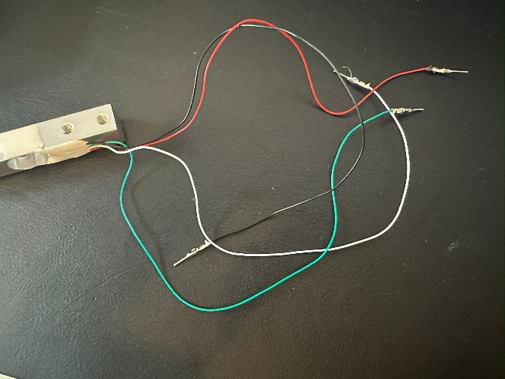
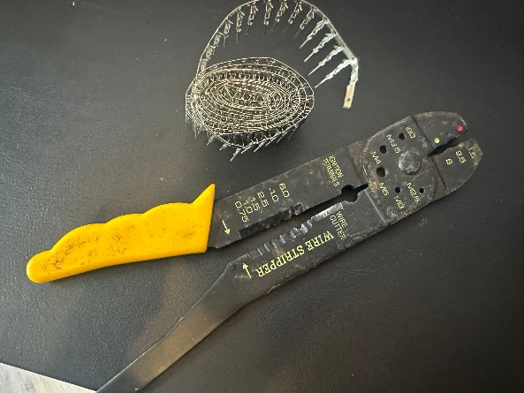
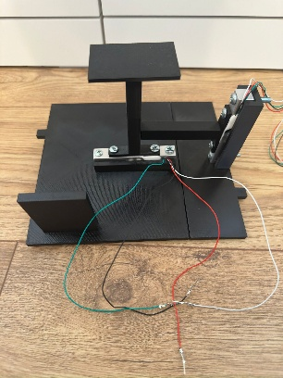
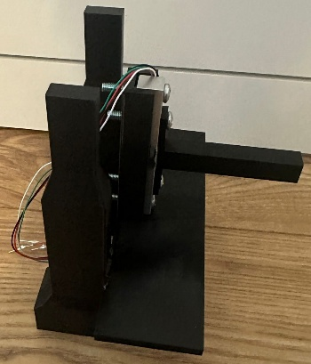
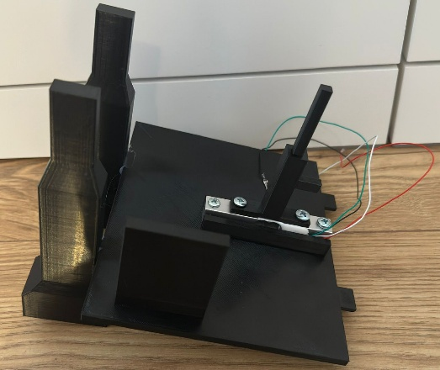
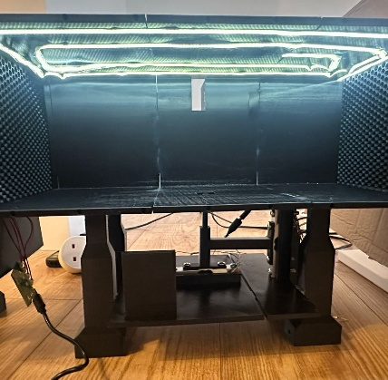
Building the tunnel
As the loadcell had bare wires to connect them, and I don’t have soldering equipment, I crimped the wires into male DuPont connecters, so that I could easily insert them into a breadboard
I then screwed the load cells into the electronic stand
I then glued each side of the electronic stand, into their corresponding supports
I then glued the supports (including the electronics stand) into the main frame

Slide 13




Building the tunnel
I then glued the LED strip into the main frame
I then printed the water mister container sideways, to ensure it was waterproof, and I inserted the water misters and inserted the compartment into the tunnel
I then printed the window and glued in the Perspex
I then printed and added in the model stand

Slide 14







Testing:
I tested it and managed to get speeds of around 5.7ms^-1
Also, the smoke generation was quite poor and was unnoticeable at high speeds
The window was very difficult to put on and take off repeatedly after tests
There was some warping when printing the main frame so there were some slight gaps in the main frame

Slide 15



Fixing The Window:
To fix the window, I decided to only slide in and out the Perspex pane instead of taking out the whole window, so I redesigned and reprinted the starting piece of the window to allow me to slide the window in, and it worked.

Slide 16
Next Steps:
I will get duct tape and tape together the seams of the main frame of the wind tunnel
I will use cardboard and duct tape to create a seal around the diffuser and fan to ensure all suction power is directed towards the tunnel
I will investigate better ways of getting the smoke generation to be better and thicker
I will wire, setup, and code the electronics of the tunnel.

